Slide 1
Christchurch Mansion DMC Pitch
Lenneth Dayaon Willoughby Axtell

Slide 2
Group Contributors
Len Dayaon – Designer
UX Design
Character Design
Groundwork for Content
Willoughby Axtell – Programmer
UX Design
Groundwork for Content
Unreal Engine 4 (used for the app)

Slide 3
The Brief
The aim of this project is to explore how games can enrich a museum experience
The exhibition is targeted at young people (14-25yrs) and families
We aim to provoke conversations between visitors and make people think a little bit more on the stories that are told.

Slide 4
Desired Outcomes
Increase enjoyment of the collections
Increases engagement with the objects and themes of the exhibition
Increases understanding of the collections
Encourages group learning and fun activities
Increases the amount of time people spend in the exhibition
Reduces the amount of text panels on the wall in the displays

Slide 5
Our solution to the brief
We have come up with a concept whereby a digital companion acts as an intermediary for Christchurch Mansion and its exhibits
Felix Cobbold, the man who has gifted the Mansion to the town of Ipswich. Would be a fitting character to act as an intermediary because he is the reason why the Christchurch Mansion is a museum with us today.
Focus is on Empathy

Slide 6
Continuation of the concept
The concept is an app which provides a framework of which visitors can engage with the myriad history of the mansion.
This will either be provided as an app on the iPad provided or an offline app on Android, so visitors can download on their mobile device.

Slide 7
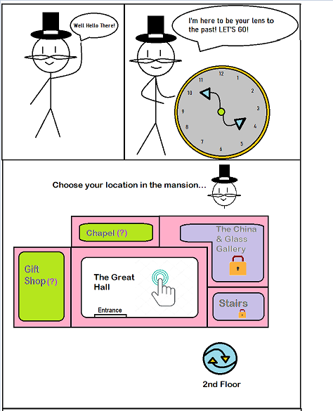
Prototype

Slide 8
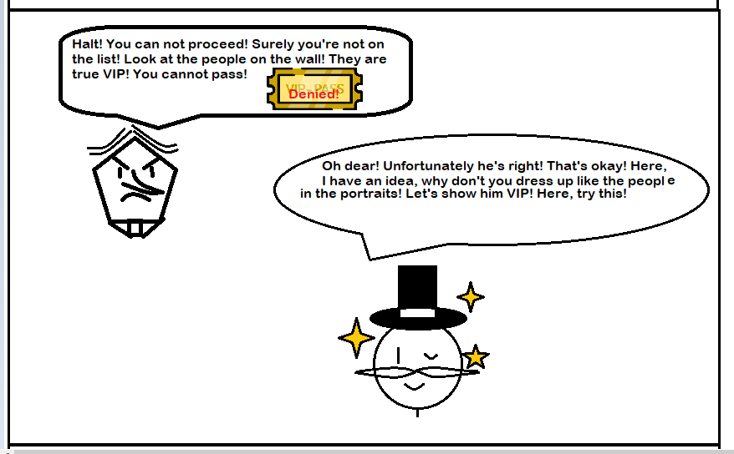
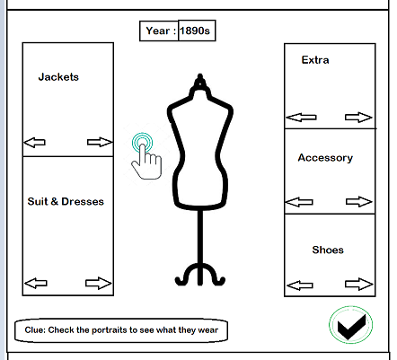
Prototype

Slide 9
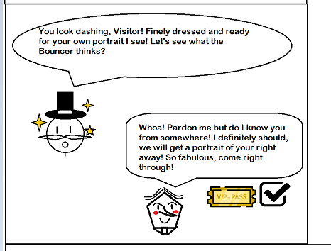
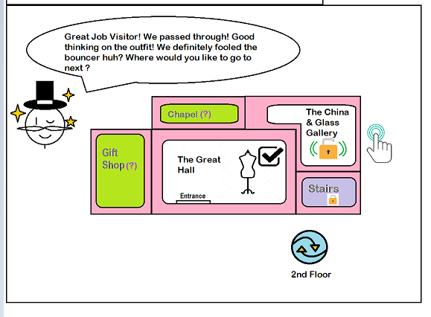
Prototype

Slide 10
Final Deliverables
A mobile game developed for android devices featuring:
At least 8 of the museums rooms containing playable minigames and information
A story revolving around the player and Felix Cobbold

Slide 11
Timeline/Milestones
November 2019 | Paper Prototypes and Concept Art Complete
December 2019 | Key Research and Core game Prototypes complete
January 2020 | Active Development Room creation: Every Week/Fortnight: research a room, create art and a minigame for it and then playtest it.
February 2020
March 2020
April 2020 | Polish existing minigames, playtest full game and fix bugs

Slide 12

Thank you! Any questions?

